Slide 1

Human Computer Interaction: Group 13
Programming
Ziruo Xiao, Luca Pinggera, Nikhil Sethukumar, Matthias Schenk
Zürich, 14. December 2022

Slide 2
Table of Contents
1 Problem and Process
2 Hi-Fi Prototype
3 A/B Test
4 Statistical Analysis
5 Conclusion and Future Work
Xiao, Pinggera, Sethukumar, Schenk| December 2022 | Human Computer Interaction
Slide 1

Slide 3
Problem and Process: Overview
Problem:
How might we introduce fundamental concepts to beginners and guide them through the learning process.
Idea:
A block-based coding environment that teaches core programming concepts to beginners by programming/modifying a rudimentary game.
Xiao, Pinggera, Sethukumar, Schenk| December 2022 | Human Computer Interaction
Slide 2

Slide 4
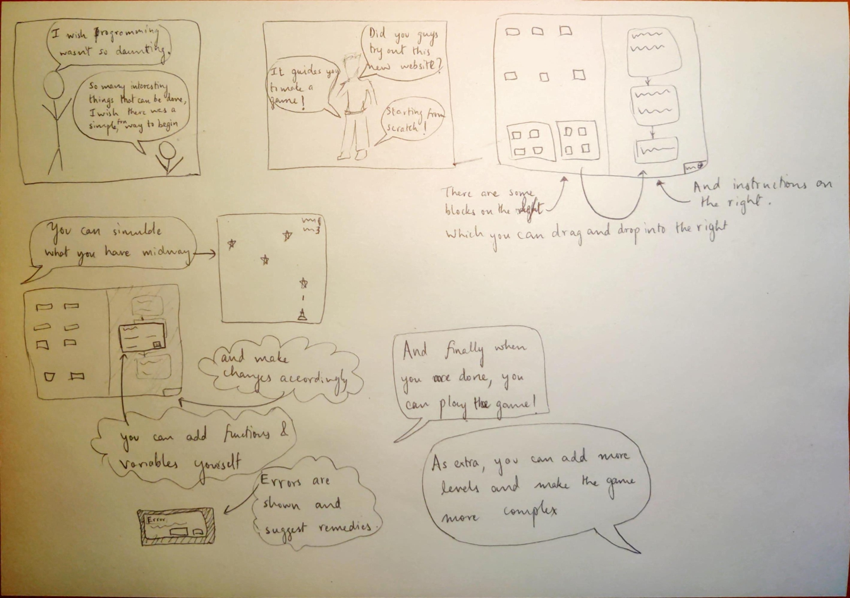
Problem and Process: Storyboard
Xiao, Pinggera, Sethukumar, Schenk| December 2022 | Human Computer Interaction
Slide 3

Slide 5
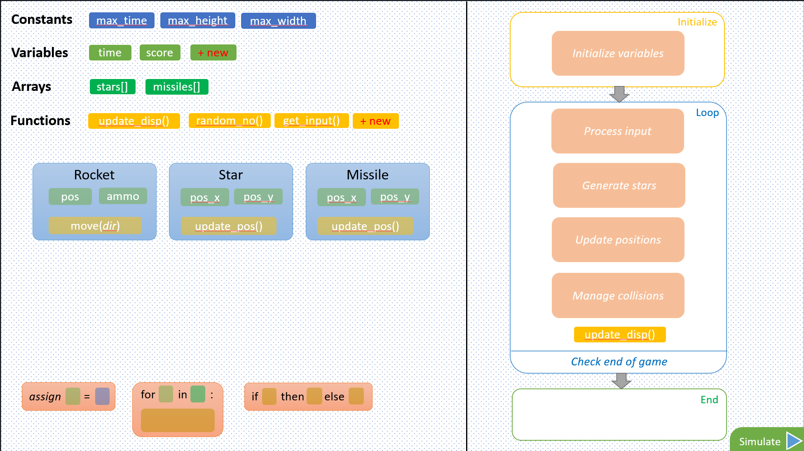
Problem and Process: Mid-Fi Prototype
Xiao, Pinggera, Sethukumar, Schenk| December 2022 | Human Computer Interaction
Slide 4

Slide 6
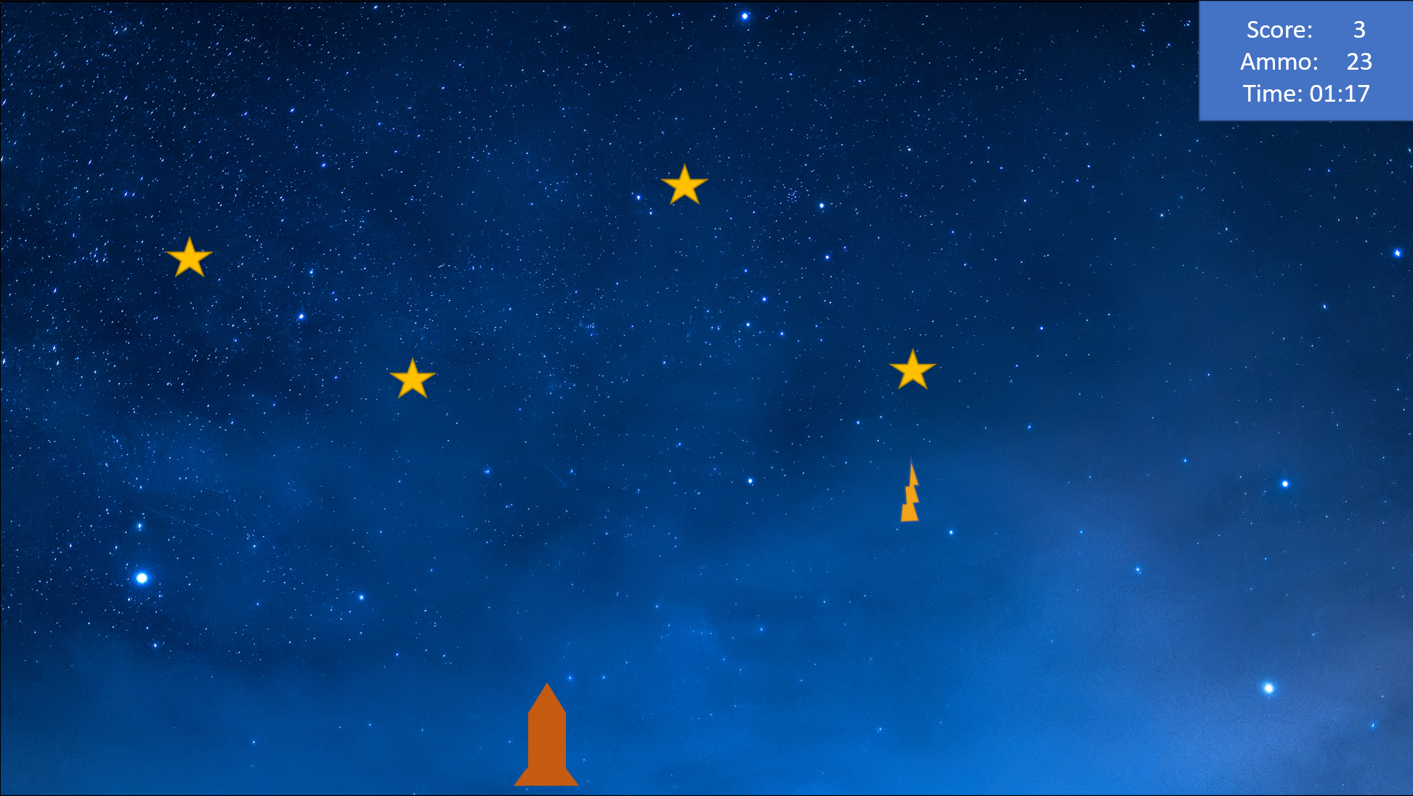
Problem and Process: Mid-Fi Prototype
Xiao, Pinggera, Sethukumar, Schenk| December 2022 | Human Computer Interaction
Slide 5

Slide 7
Hi-Fi Prototype: Video Demonstration
Xiao, Pinggera, Sethukumar, Schenk| December 2022 | Human Computer Interaction
Slide 6

Slide 8
A/B Test
Interface A:
The interface A will be a split screen with code blocks in the left window and the code framework in the right window.
Interface B:
The interface has a singel centerd window with the code framework. Once a location is selected a second window appears to the left side where that shows eligible blocks for that position.
Xiao, Pinggera, Sethukumar, Schenk| December 2022 | Human Computer Interaction
Slide 7

Slide 9
Statistical Analysis
Hypothesis 1: There will be no effect of the block selection interface on the users perceived ease of use.
Hypothesis 2: There will be no effect of the block selection interface on the task completion time.
Hypothesis 3: There will be no effect of the block selection interface on the number of clicks the user does.
Xiao, Pinggera, Sethukumar, Schenk| December 2022 | Human Computer Interaction
Slide 8

Slide 10
Conclusion and Future Work
Conclusion:
Interface A had faster completion time and fewer required clicks for the task completion with no significant impact on easiness of use.
Future Work:
Design introductory tasks for the user
Implement hints and descriptions for buttons
Improve precision of drag-and-drop
Extend the colour coding
Xiao, Pinggera, Sethukumar, Schenk| December 2022 | Human Computer Interaction
Slide 9

Slide 11
Thank you!
Xiao, Pinggera, Sethukumar, Schenk| December 2022 | Human Computer Interaction
Slide 10

